Slide 1
Digital Portfolio
STUDENT NAME: SARATHI M
REGISTER NO:20324u48028
NMID: EC1AA8DFAFF12EAA13F4AE7124ABCD10
DEPARTMENT:B.SC DATA SCIENCE
COLLEGE: Dr. M. G. R. Chockalingam Arts College
UNIVERSITY: Thiruvalluvar University

Slide 2
PROJECT TITLE
Student Personal Digital Portfolio

Slide 3
AGENDA
Problem Statement
Project Overview
End Users
Tools and Technologies
Portfolio design and Layout
Features and Functionality
Results and Screenshots
Conclusion
Github Link

Slide 4
PROBLEM STATEMENT
Many people need a way to show their skills, projects, and experience online clearly and professionally. Without a good website, it’s hard to stand out and get noticed by employers or clients.
This project, "Student Personal Digital Portfolio," will create a simple, easy-to-use website using HTML, CSS, and JavaScript. The website will help showcase my work and skills so others can learn more about me and what I can do
.

Slide 5
PROJECT OVERVIEW
The "Student Personal Digital Portfolio" project is focused on creating a personal website that highlights my skills, projects, and contact information. Using HTML, CSS, and JavaScript, this portfolio will serve as a digital resume and showcase my work in a clean, organized, and visually appealing way.
The portfolio will include sections such as About Me, Skills, Projects, and Contact. It will be responsive, meaning it works well on both computers and mobile devices. The goal is to create an easy-to-navigate site that helps potential employers or clients quickly understand my abilities and reach out to me.

Slide 6

WHO ARE THE END USERS?
The main users of this personal portfolio website are:
Potential Employers: To review my skills, experience, and projects when considering me for job opportunities.
Clients: To evaluate my work and decide if they want to hire me for freelance or contract projects.
Collaborators and Peers: Other developers or designers who want to connect, network, or collaborate on projects.
General Visitors: Anyone interested in learning more about my professional background and capabilities.

Slide 7
TOOLS AND TECHNIQUES
HTML5 – To create the structure and content of the portfolio website.
CSS3 – To style the website and make it visually appealing and responsive.
JavaScript – To add interactivity and dynamic features, such as smooth scrolling and form validation.
Code Editor (e.g., Visual Studio Code) – For writing and managing the code efficiently.
Browser Developer Tools – To test, debug, and optimize the website during development.
Git & GitHub – For version control and hosting the project online (optional but recommended).

Slide 8
POTFOLIO DESIGN AND LAYOUT
The portfolio website will be simple, clean, and easy to use. It will have these main parts:
Header and Menu
A menu at the top with links to About Me, Skills, Projects, and Contact.
Clicking links will smoothly scroll to the right section.
About Me
A short introduction about me with a photo.
Skills
A list of the skills I have.
Projects
A few of my best projects with short descriptions and links.
Contact
A form where visitors can send me a message.
My email and social media links.
Footer
Copyright info and extra links.
The website will work well on computers, tablets, and phones, so anyone can view it easily.
8

Slide 9
FEATURES AND FUNCTIONALITY
Responsive Design: The website looks good and works well on all devices, including desktops, tablets, and smartphones.
Navigation Menu: Easy-to-use menu with links to different sections for quick access.
Smooth Scrolling: Clicking a menu link smoothly scrolls to the selected section.
About Me Section: Displays a brief introduction and photo.
Skills Section: Lists key skills and technologies I know.
Projects Section: Shows important projects with descriptions and links to live sites or code.
Contact Form: Visitors can send messages directly through the website.
Form Validation: Checks that the contact form is filled correctly before submitting.
Footer: Contains copyright and social media links.

Slide 10
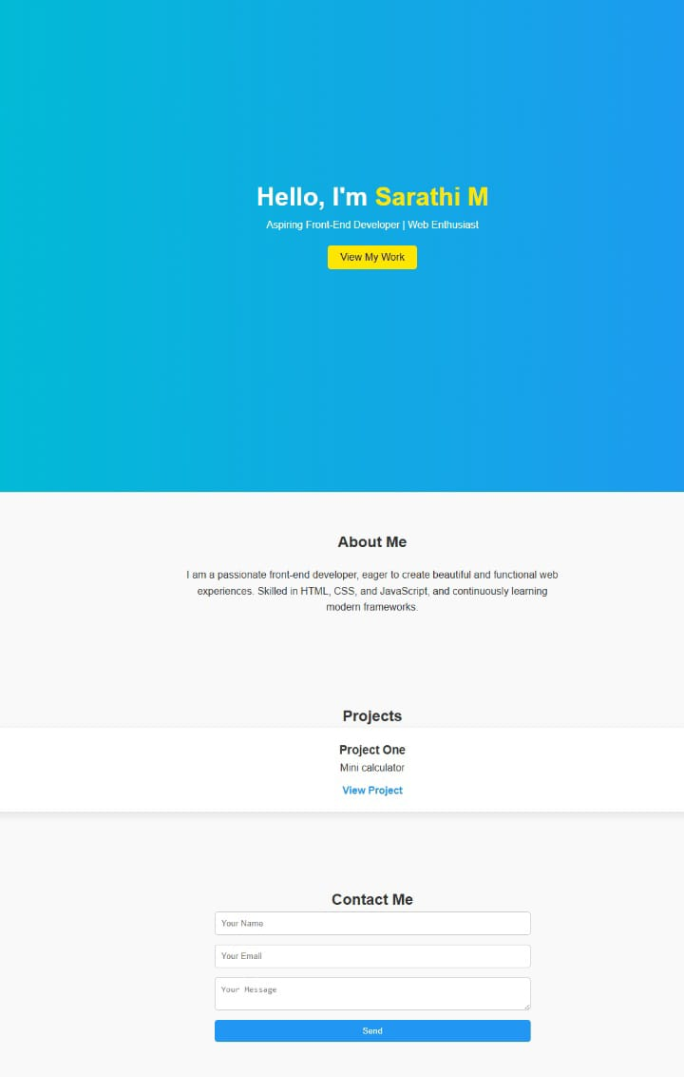

RESULTS AND SCREENSHOTS
3/21/2024 Annual Review
10

Slide 11
CONCLUSION
The "Student Personal Digital Portfolio" project creates a clean and professional website to showcase my skills, projects, and contact information. This portfolio helps me present myself clearly to potential employers and clients, making it easier for them to learn about my work and reach out.
By using HTML, CSS, and JavaScript, the website is both attractive and easy to use on all devices. This project is an important step in building my personal brand and growing my career in web development
11

Slide 12
Github Link
PROJECT LINK: https://github.com/sarathi20324u48028-ux/Digital-Portfolio.git
OUTPUT LINK: https://sarathi20324u48028-ux.github.io/Digital-Portfolio/

